Slide 1
Photogrammetry as an Effective Method of Analyzing Fossils
By – Tyler Gates

Slide 2
Why?
I would like to see if photogrammetry, combined with lidar scans, would be an effective method of analyzing fossils.
I am hoping to find that the models will be accurate and precise enough to take measurements of different parts of the skulls.
If this is successful, a new opportunity for researchers will arise.
Those who would like to analyze bones and fossils in foreign repositories will be able to do so without the need to travel, and instead do it from their offices and home computers.
It would be easier, less expensive and safer to both construct and analyze fossils for academic and entertainment purposes.

Slide 3
Methods
I have scanned the fossils with the Leica P40 machine alongside Zach and Max. We placed the machine in 6 different locations in a room in order to accurately scan each fossil of interest. The models were scanned at a resolution of 6.3mm @ 10m.
In Cyclone, the photos were aligned using the visual alignment technique; the rectangular room helped a lot with this. The error was kept below an average of 0.02m. All the irrelevant points were deleted after rendering.
Around 90 images were taken of each skull to be used in the photogrammetry process using a early Canon Rebel model camera. 2 chunks were created for each side of the skull, then combined to form a complete model. These models were then cleaned and texture refined to make the most accurate model possible.

Slide 4
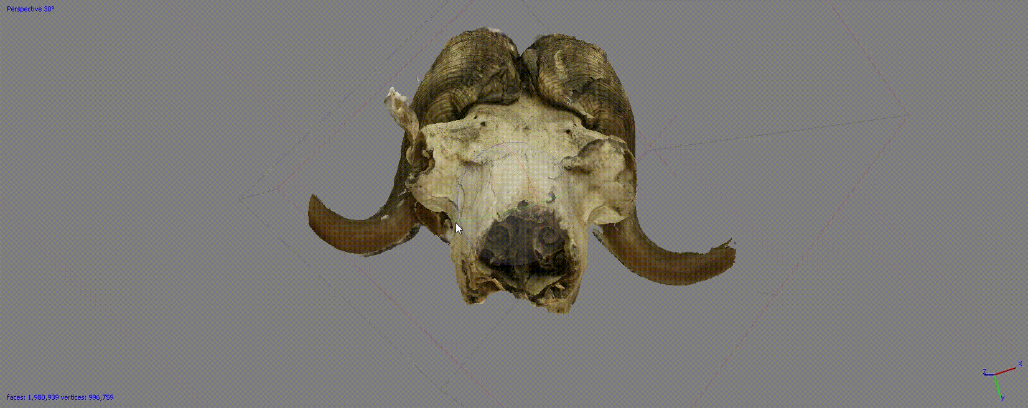
Photogrammetry
Photogrammetry = the process of producing a 3D point cloud from images of an object.
These photos are taken all around an object at an equal distance away. The camera captures the object at many angles, with a minimum of around 40% overlap in-between.
This same concept applies to aerial lidar scanning.
The images are then stitched together using common, defined points in each image; this could include the ends of the horns, eye sockets, and teeth in the skull.

Slide 5
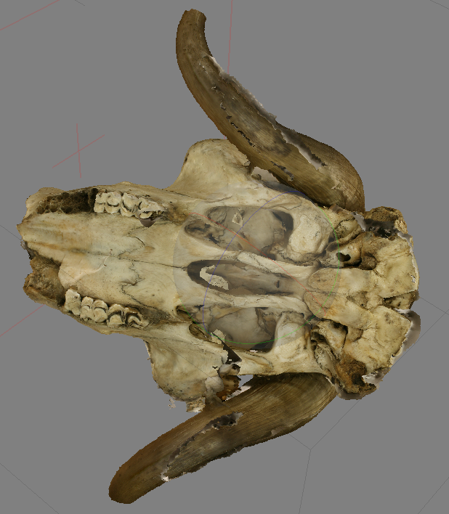
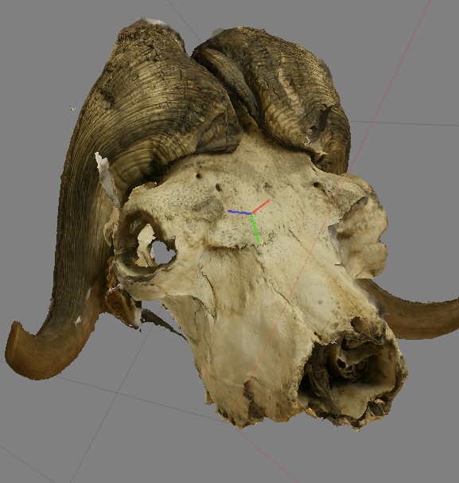
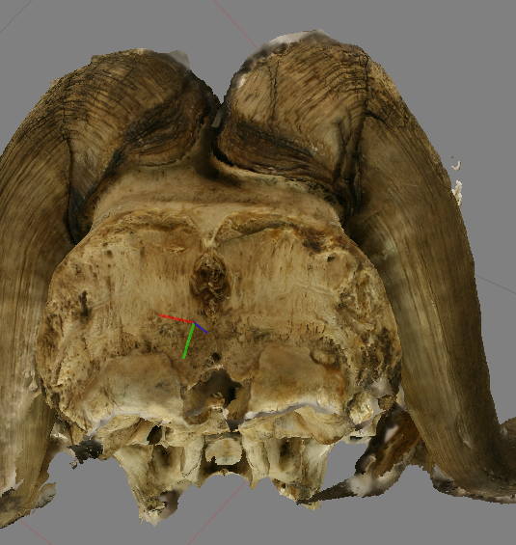
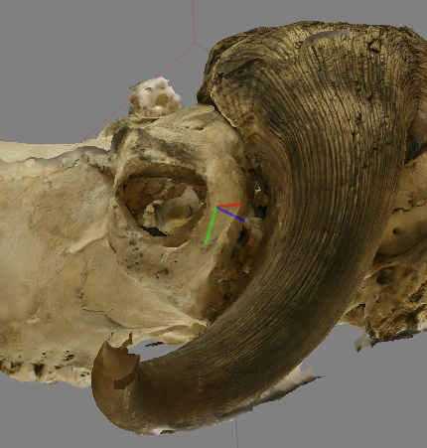
Progress
Photogrammetric Models

Slide 6
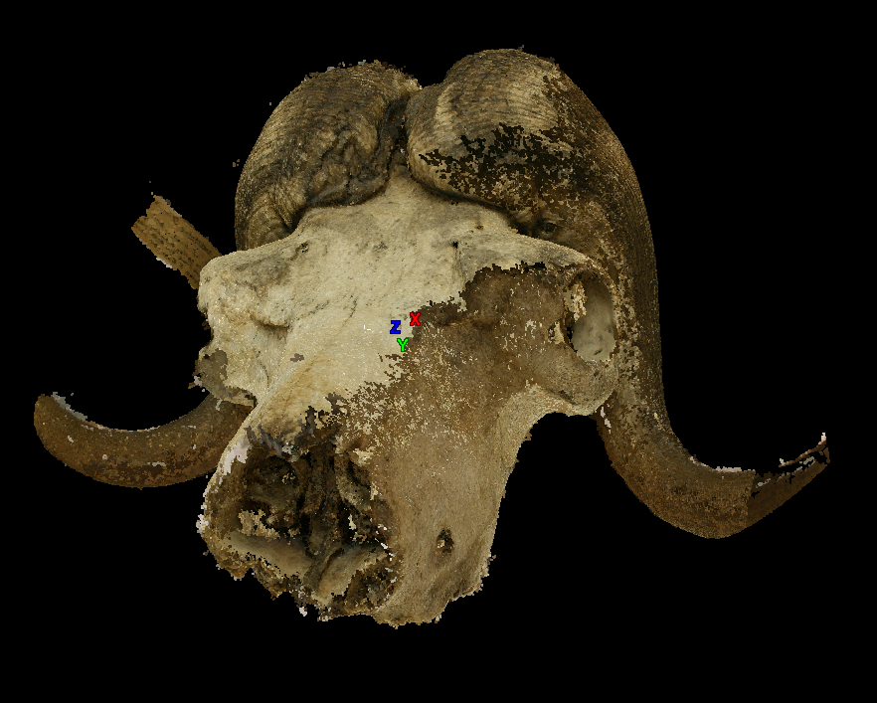
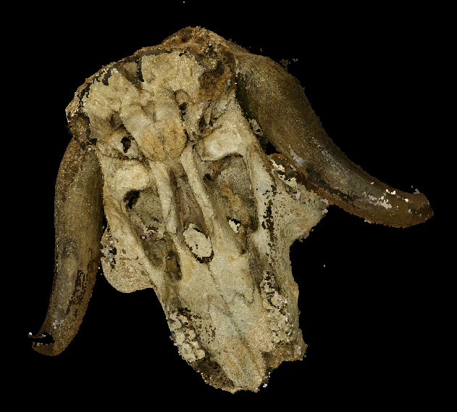
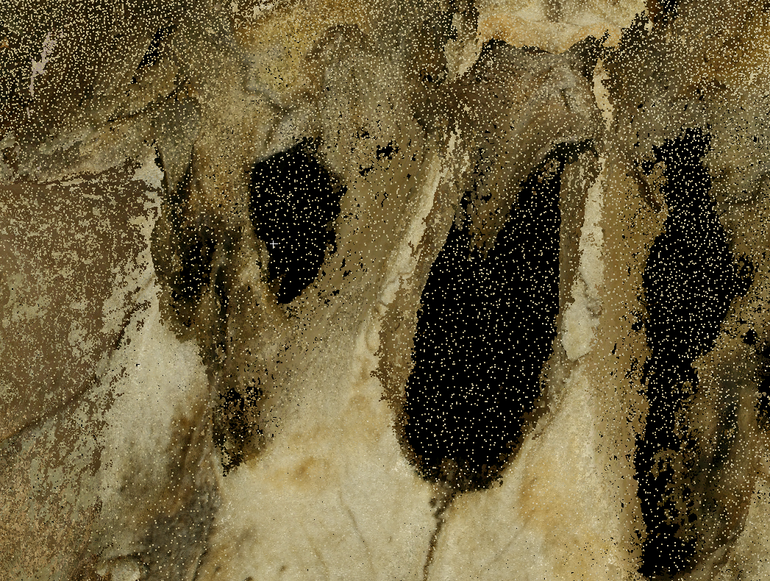
Progress
Photogrammetric Model Point Cloud
Total Points: ~25,127,229

Slide 7
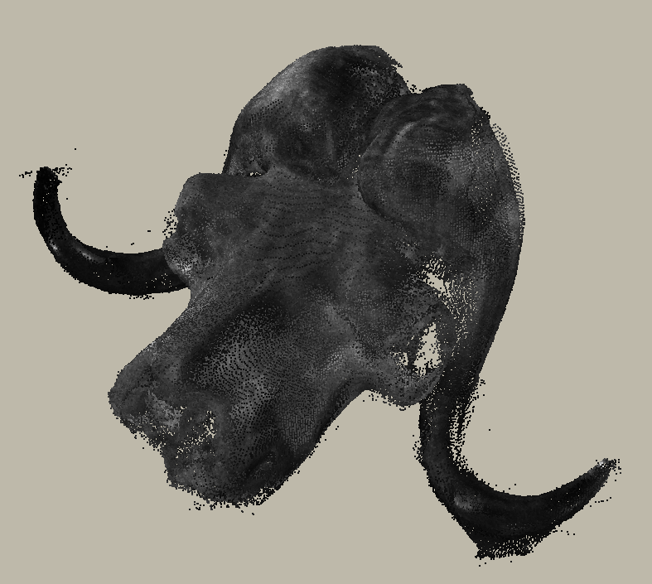
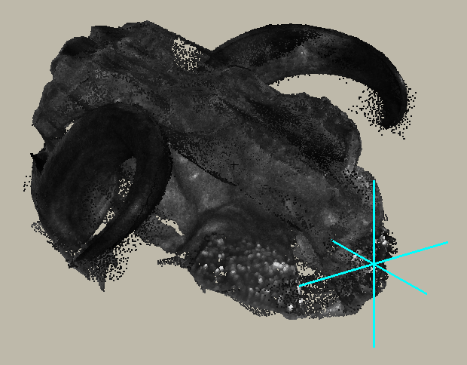
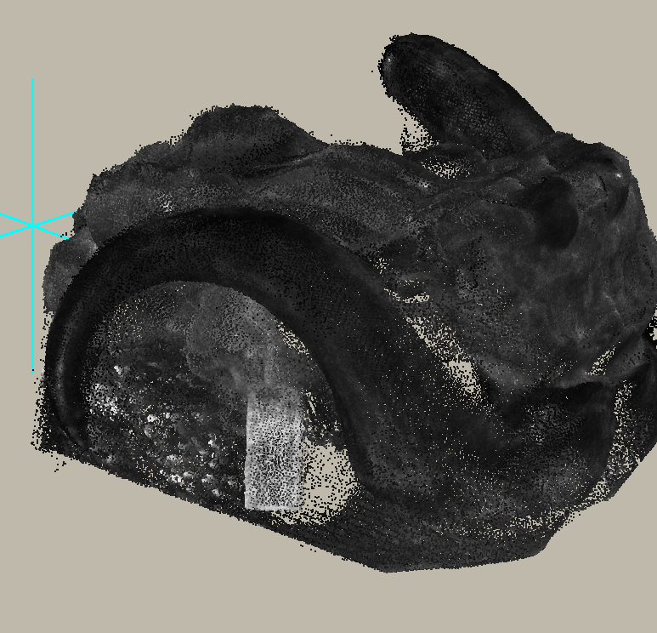
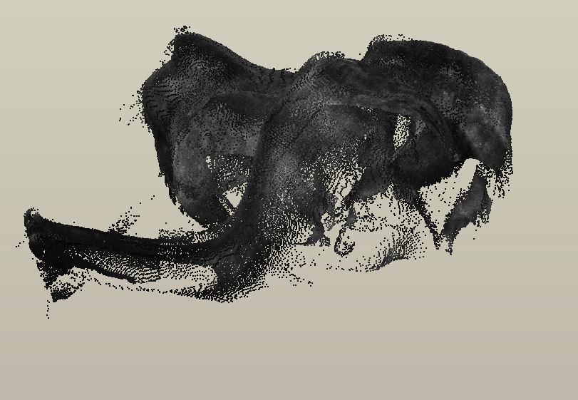
Progress
Lidar Scan Point Cloud
Resolution: 6.3mm @ 10m
Total Points: ~1,379,860

Slide 8
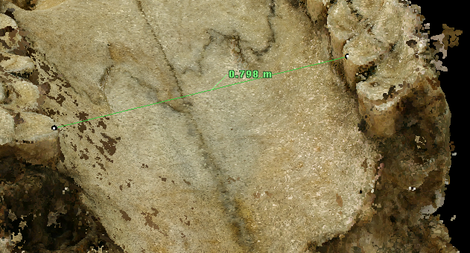
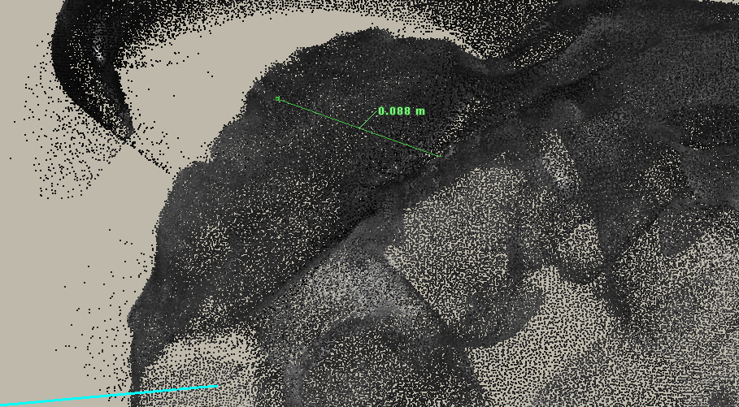
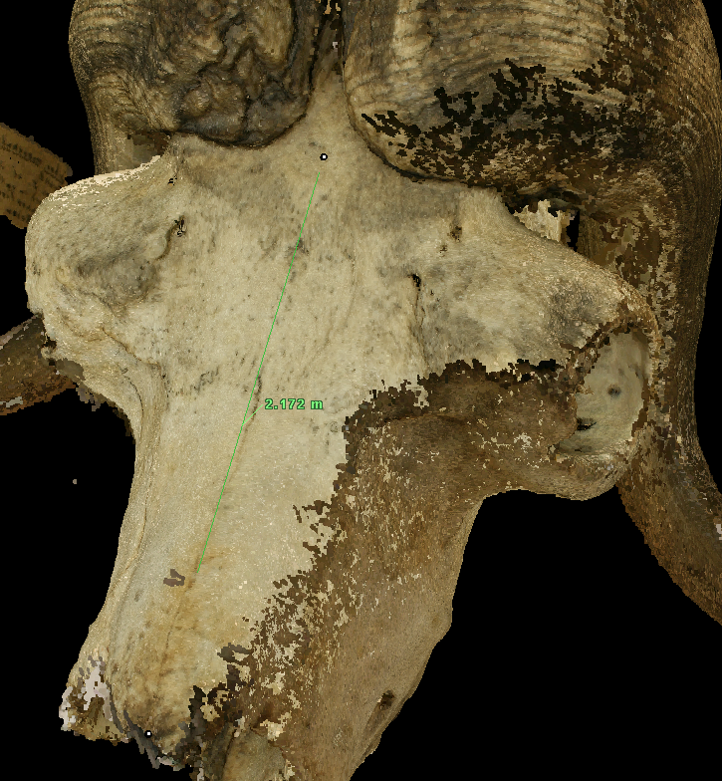
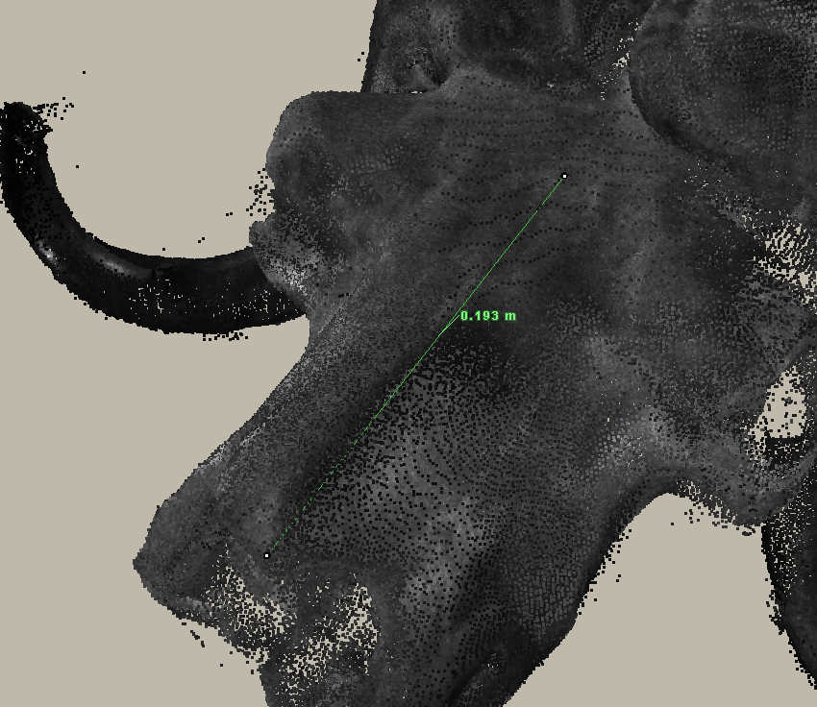
Measurements
Two measurements were tested:
One between an identical pair of teeth, and another from the tip of the skull to the crown.

Slide 9
Results
Lidar scanning tend to be more accurate in terms of measuring the physical size of an object.
The actual size of an object is accurate due to the measurements the lidar machine saves at the time of collection.
The photogrammetry does not have a reference to the actual size of the object, making measurements difficult to perform.
Photogrammetry is a better way of assessing the physical features of a smaller object.
The dense cloud produced by photogrammetry was much more detailed than that taken by our lidar machine.
Exploring the features of the fossil is a much more rewarding task with the photogrammetric model as opposed to the sparsely-detailed lidar scans.

Slide 10
To-Do & Changes
I will be attempting to combine both the photogrammetric models and the lidar models together to create a measurable and accurate 3D model.
If this is successful, this process will prove to be a great way to analyze objects of interest in the academic or entertainment fields.
Need to get actual skull measurements for accurate comparison
Changes
Scan each skull / bone one at a time, not all together
Have a better + more consistent lighting source for taking photos / use a rotating stand
Use a more updated camera for even higher resolution images

